Slide 1

C Programming tutorial
By Aman Tiwari

Slide 2
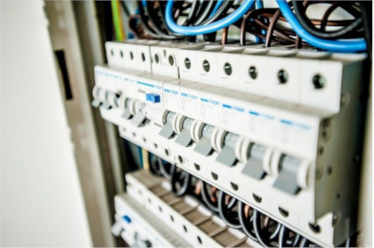
What is a Programming Language
A programming language is a set of instructions that can be used to interact with and control a computer. These languages are used to design websites, create apps, develop operating systems, control spacecraft, and analyze data. Programming languages are necessary because computers can't understand English. Programming languages bridge this gap by helping programmers translate their commands into something that the computer can understand and execute.
Computers are made of many tiny switches that can be either on or off. When a switch is on, it is represented by a 1. When it is off, it is represented by a 0. These 1s and 0s are called bits. Bits are the fundamental language of nearly all computers and every program must be translated into bits before it can be executed by the computer. When 8 bits are grouped together, this is called a byte. A byte can represent a letter, for example, 01100001 represents 'a'. A byte can also represent a control character.
For example, 00000011 signals the end of a piece of text. When representing a number using bits, it can be converted from its normal base 10 representation to binary. This is called binary representation.

Slide 3
Types of Programming Languages
There are three types of programming languages: machine language, assembly language, and high-level language.
Machine language(low level) is easier for the computer to understand but harder for the programmer to understand. This is because machine language is simply the language of machines—bits. Sometimes, programmers will develop programs directly with machine code, but because this is difficult to understand and tedious to type, it is more common to program using assembly or a high-level language.
Assembly language(mid level) is slightly easier to understand. The bits of machine language are replaced by numbers and English commands. Before assembly code is run by the computer, it is assembled by an assembler. This converts the code back into the 1s and 0s of machine language that the computer can understand.
High-Level languages use many more English commands and are significantly more readable than assembly or machine language. Many high-level languages have built-in commands that help the programmer write loops, create variables of different data types, and manipulate strings. It is worth noting that all of these are possible in assembly or machine language, but high-level languages make them much easier for the programmer to read, write, and debug. Some newer high-level languages are scripting languages. This means that they are not compiled, or translated into machine language, until just before the code is executed at runtime. Python, Javascript, PHP, Ruby, and Bash are all scripting languages.

Slide 4
Programming Languages
Low level | Mid Level | High Level
They are machine dependent which directly access the machine resources using bits , CPU registors, pointers,etc | It is machine independent and it contains 50% features of low level and 50% Features of high level. Eg. C & C++ | They are platform (hardware+software) independent and they Follows another methodology like OOPs (object oriented programming ). Eg. Java ,python,C# etc

Slide 5
History of C language is interesting to know. Here we are going to discuss a brief history of the c language.
C programming language was developed in 1971 by Dennis Ritchie at bell laboratories of AT&T (American Telephone & Telegraph), located in the U.S.A.
Dennis Ritchie is known as the founder of the c language.

Slide 6
What is C and Why C ?
The C Language is developed for creating system applications that directly interact with the hardware devices such as drivers, kernels, etc.
It provides feasible interaction with hardware devices without compromising on the performance.
C programming is considered as the base for other programming languages, that is why it is also known as mother language.
It can be defined by the following ways:
Mother language
System programming language
Procedure-oriented programming language
Structured programming language
Mid-level programming language

Slide 7
C as a mother language
C language is considered as the mother language of all the modern programming languages because most of the compilers, JVMs, Kernels, etc. are written in C language, and most of the programming languages follow C syntax, for example, C++, Java, C#, etc.
2) C as a system programming language
A system programming language is used to create system software. C language is a system programming language because it can be used to do low-level programming (for example driver and kernel). It is generally used to create hardware devices, OS, drivers, kernels, etc. For example, Linux kernel is written in C.

Slide 8
3) C as a procedural language
A procedure is known as a function, method, routine, subroutine, etc. A procedural language specifies a series of steps for the program to solve the problem.
A procedural language breaks the program into functions, data structures, etc.
C is a procedural language. In C, variables and function prototypes must be declared before being used.
4) C as a structured programming language
A structured programming language is a subset of the procedural language. Structure means to break a program into parts or blocks so that it may be easy to understand.
In the C language, we break the program into parts using functions. It makes the program easier to understand and modify.

Slide 9
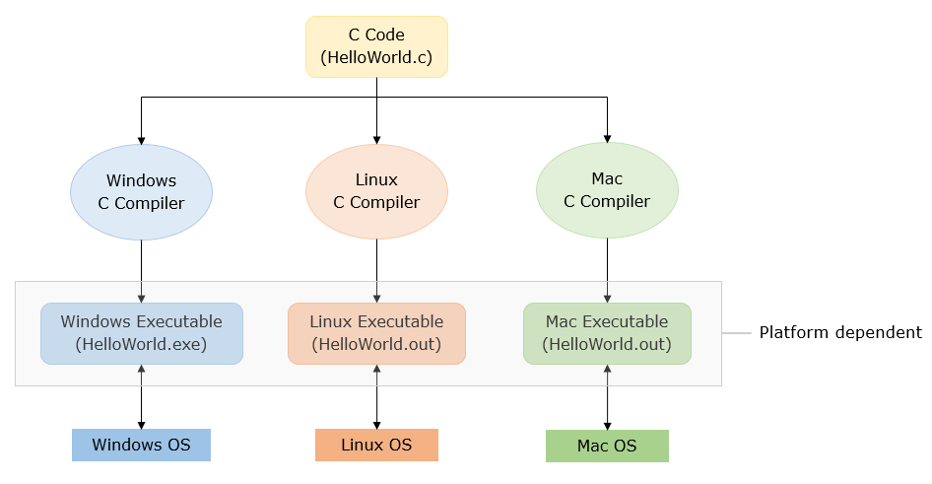
Why c is not platform independent
Sometimes, it means the same as "hardware dependent" or "machine dependent" and refers to applications that run in only one hardware series with the operating system not being relevant. In contrast, "platform independent" means that the application can run in different operating environments.

Slide 10
Let’s Start with C
Steps in learning English language:
Alphabets
Words
Sentences
Paragraphs
Steps in learning C:
Alphabets
Digits
Special
symbols
Constants
Variables
Keywords
Instructions
Program

Slide 11
Basic Structure of C Program In modern Compilers
#include <stdio.h>
int main()
{
printf("Hello in C Programming");
return 0;
}
// standard input output header file
// Starting point of a program
// Starting body of main
// Printing output on console
// Semicolon(;) means end of line or statement(instruction)
//Ending point of a program
// Ending of body

Slide 12
Basic Structure of C Program In Turbo C/C++
#include <stdio.h>
#include<conio.h>
int main()
{
clrscr();
printf("Hello C Programming\n");
getch();
return 0;
}

Slide 13
C Keywords
Keywords represents words whose meaning have been already explained to the C Compiler.
Keywords cannot be used as variable names.
Keywords are also called ‘Reserved words’.
32 keywords available in C are:
auto | double | int | struct
break | else | long | switch
case | enum | register | typedef
char | extern | return | union
cont | float | short | unsigned
continue | for | signed | void
default | goto | sizeof | volatile
do | if | static | while

Slide 14
Environment setup
C code
(English)
Desktop
(Binary 0 1 )
Compiler
Text Editor :- Compiler :- Device (Terminal) :-
Eg. Notepad,Notepad++, GCC (GNU compiler command prompt,
Sublime,atom,brackets, collection) ,bcc,MinGW, powershell,Terminal
Vs code etc. onleinegdb compiler etc. etc.

Slide 15
IDE : Integrated Development Environment ( ide = text editor + compiler + terminal + intellisence etc)
Eg. Turbo C/C++ ,code blocks, dev c/c++ , eclipse ,visual studio ( > 20 GB ) etc.
My Combination : VS code + GCC + powershell /cmd
For Begginers : dev c/c++ ,code blocks
https://jmeubank.github.io/tdm-gcc/download/
https://code.visualstudio.com/download
https://sourceforge.net/projects/dev-cpp/files/Binaries/Dev-C%2B%2B%204.9.9.2/devcpp-4.9.9.2_setup.exe/download
https://sourceforge.net/projects/codeblocks/files/latest/download

Slide 16
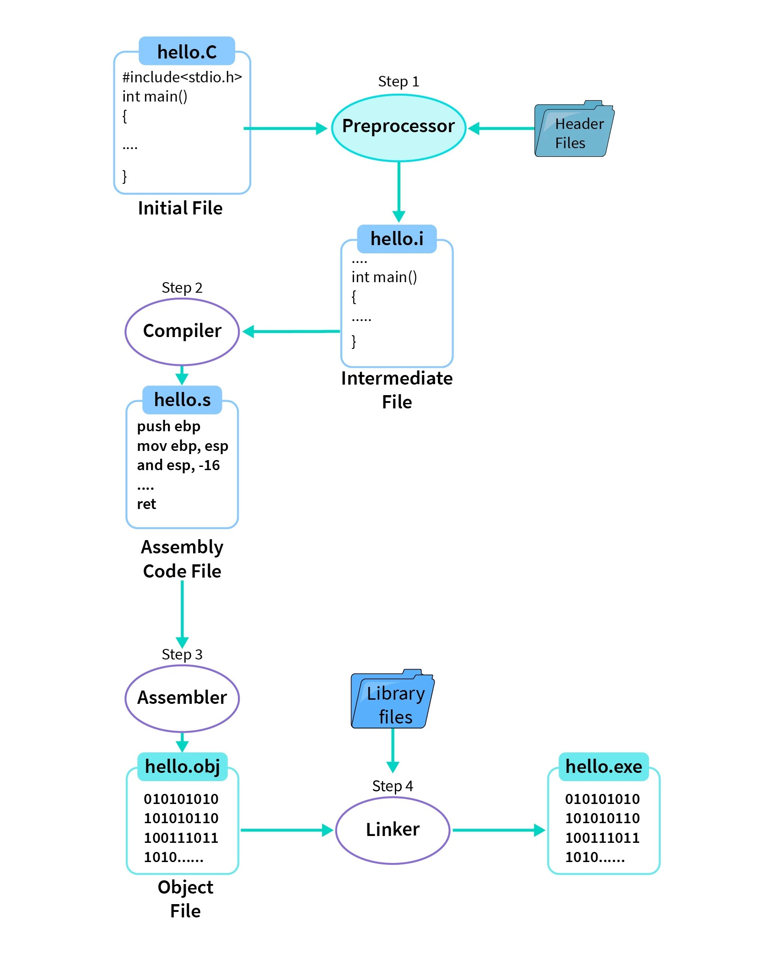

Slide 17

Thank You
AMANTIWARI8861@GMAIL.COM

